Slide 1

Health Emergency Preparedness Response and Resilience- Focus on AMR and IPC
Dr. Evelyn Wesangula Senior AMR Control Specialist East, Central and Southern Africa Health Community 12th IPNET-K Conference, Mombasa Kenya

Slide 2

Introduction
AMR is a growing global crisis threatening decades of progress
Contributing factors: OTC antibiotics, empirical treatments, counterfeit drugs and poor stewardship and infection prevention and control pract
Africa faces dual burden: infectious diseases and epidemics
Ebola, COVID-19, Mpox, Cholera Marburg challenge system resilience
Do these epidemics hinder or enable AMR containment?
Effects: longer stays, higher costs, morbidity and mortality

Slide 3
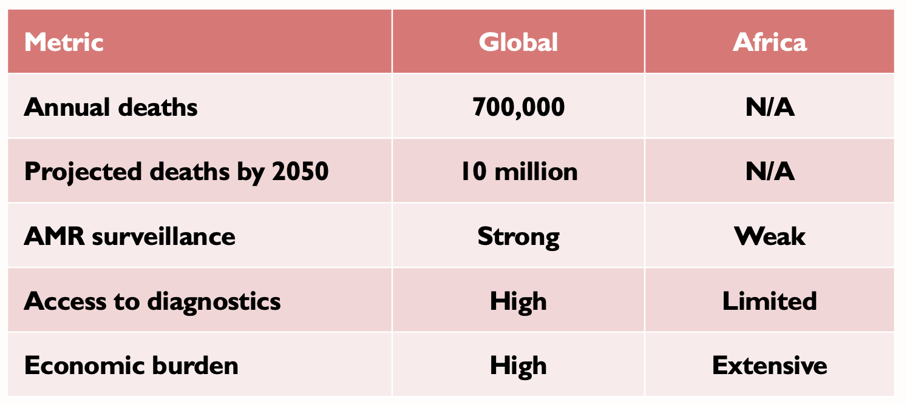
AMR burden and impact
AMR causes over 700,000 deaths annually worldwide, projected to reach 10 million by 2050.
Africa faces high resistance levels and economic burden

Slide 4
NAP objectives pose key challenges in the African context, requiring prioritized solutions across sectors
1
2
3
      Address drivers of
      AMR in Africa
      Build evidence
      and reporting
      Mobilize and
      coordinate resources
  Low uptake of WASH and IPC measures remains a persistent issue on the continent
  Mixed levels of AMR awareness among health workers, policy makers, and the general public
  Actions are taken to improve
  specific drivers, without taking
  an ecosystem approach
  (e.g. need to improve both capacity and training in laboratories)
  Global reporting platforms often focus on the global north due to lack of data from the global south
  (e.g. Resistance Map)
  Unequal sector coverage
  (e.g. human health baselines can be triangulated, animal/plant health presents significant data gaps)
  Country-specific approaches
  are difficult to compare
  Lack of consistent and sustainable funding (e.g. due to high reliance on international donors)
  Funding can be misaligned
  with areas of need (e.g. surveillance vs. prevention/access)
  Unclear ownership across sectors/departments of AMR
  initiatives
Source: Expert workshop questionnaire, desktop research, BCG analysis

Slide 5
Africa falls behind on key AMR interventions of IPC/WASH, setting baselines and targets, and using data to inform policies
 |  | Africa | The Americas | Eastern Mediterra-nean | Europe | South-East Asia | Western Pacific | Global average
 | AMR intervention | Average score per region from countries reporting to TrACSS (%, 2023)
Address drivers of AMR in Africa | IPC/WASH: Programs implemented nationwide per WHO guidelines | 13% | 37% | 47% | 57% | 36% | 45% | 39%
 | Awareness: Nationwide, government-supported campaigns | 33% | 23% | 35% | 53% | 45% | 41% | 38%
 | Stewardship: Adopted AWaRe antibiotic classification on NEMLs | 57% | 33% | 53% | 39% | 73% | 27% | 47%
Build evidence and improve reporting | Set baselines: Adequate technical capacity, resources and systems to collect data across sectors | 11% | 13% | 18% | 20% | 36% | 18% | 19%
 | Set targets: AMC/U data is used to inform decision-making and policies | 35% | 60% | 35% | 90% | 73% | 82% | 62%
 | Improve reporting: Established or starting implementation of integrated surveillance system for AMR | 50% | 47% | 47% | 51% | 55% | 50% | 50%
Mobilize and coordinate resources | Governance: Data is used to advocate for policy change/resource allocation | 9% | 17% | 65% | 33% | 45% | 27% | 23%
 | One Health approach: Formalized, joint or integrated sectoral coordination | 48% | 43% | 35% | 61% | 91% | 45% | 54%
Above global average
Below global average
+/-5% global average
Priority improvements
Note: 46/47 African countries report to TrACSS vs. 131/148 globally; Data is self-reported by country representatives; Where questions were left blank, it was assumed countries were not implementing the intervention
Source: Tracking AMR Country Self-assessment Survey – TrACSS (7.0) 2023

Slide 6
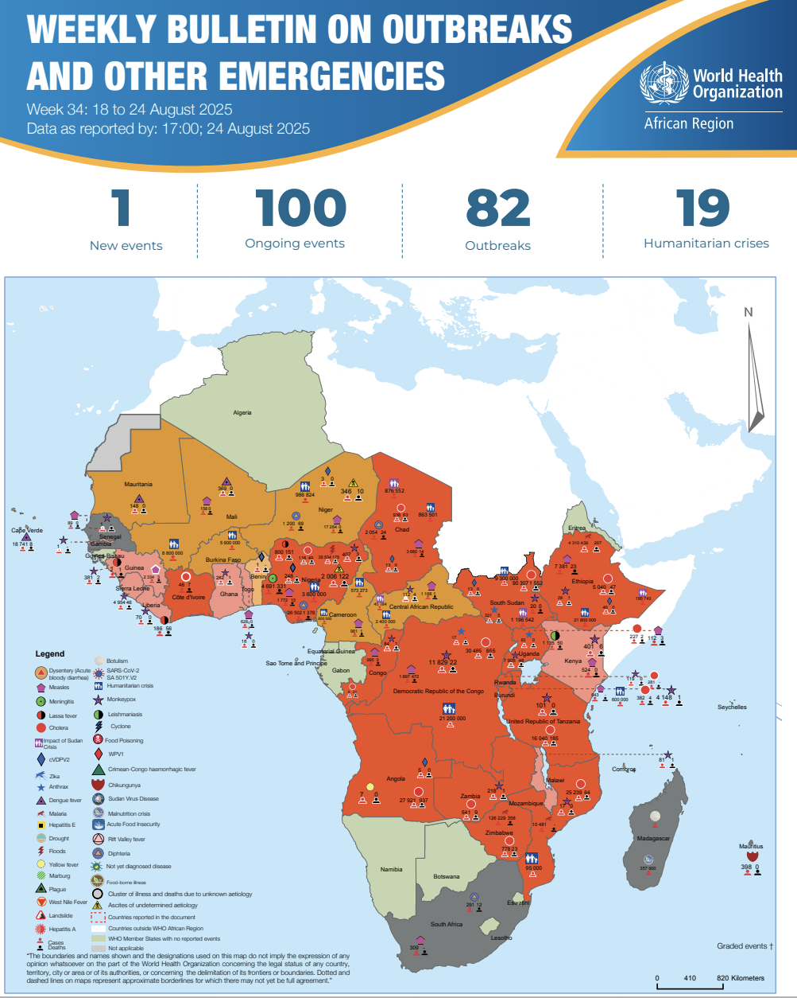
Framework-Prevent → Preparedness → Detect → Respond → Recover
Align national plans with facility SOPs; clarify roles & triggers
Cross-sector links (human, animal, environment) for signals and response

Slide 7
Epidemics as Barriers
Resources diverted
AMR programs neglected
Disrupted supply chains
Reduced regulatory enforcement
Weak IPC and overcrowding accelerate transmission, including MDROs
Data systems break down → delayed detection and response

Slide 8
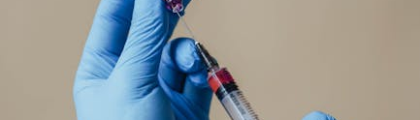
Epidemics and Antibiotic Use
COVID-19: antibiotics prescribed despite viral cause.
  No diagnostics
  Self-medication surged
  Black market sales
  Result: more resistant strains.

Slide 9

Health System Overload and Gaps
Stewardship programs paused
Labs focused on outbreak testing
Drug stockouts, inappropriate substitutions
Infrastructural challenges,
Burnout, increased HAIs

Slide 10
Infection Prevention and Control (IPC) Gap
IPC lapses → HAIs
Challenges: isolation, hand hygiene, WASH
Guidelines outdated, poorly enforced
Training not sustained

Slide 11
Epidemics as Enablers – Catalyzing Surveillance
Surveillance Outbreak Response Management and Analysis System SORMAS, DHIS2 scaled
Enabled real-time tracking
Opportunity to integrate AMR and IPC indicators

Slide 12
Strengthening Diagnostics and Laboratory Networks
COVID-19 boosted labs (PCR, GeneXpert
QA systems improved
.
Genomic surveillance can detect resistance trends
TITLE 04
Make a big impact with professional slides and charts.

Slide 13
Multisectoral Collaboration
One Health boosted via zoonotic outbreaks
Collaboration: health, agriculture, environment
AMR surveillance can be embedded

Slide 14
Investment in Health Systems Resilience
EOCs, IMS, lab capacity scaled
Digital tools improved
Supply chains, surge rosters established

Slide 15
Regional Policy Momentum
Africa CDC: AMRSNET
40+ countries have AMR NAPs
NAPs align with IHR, JEE
Partners: AU, WHO AFRO, ECSA-HC

Slide 16
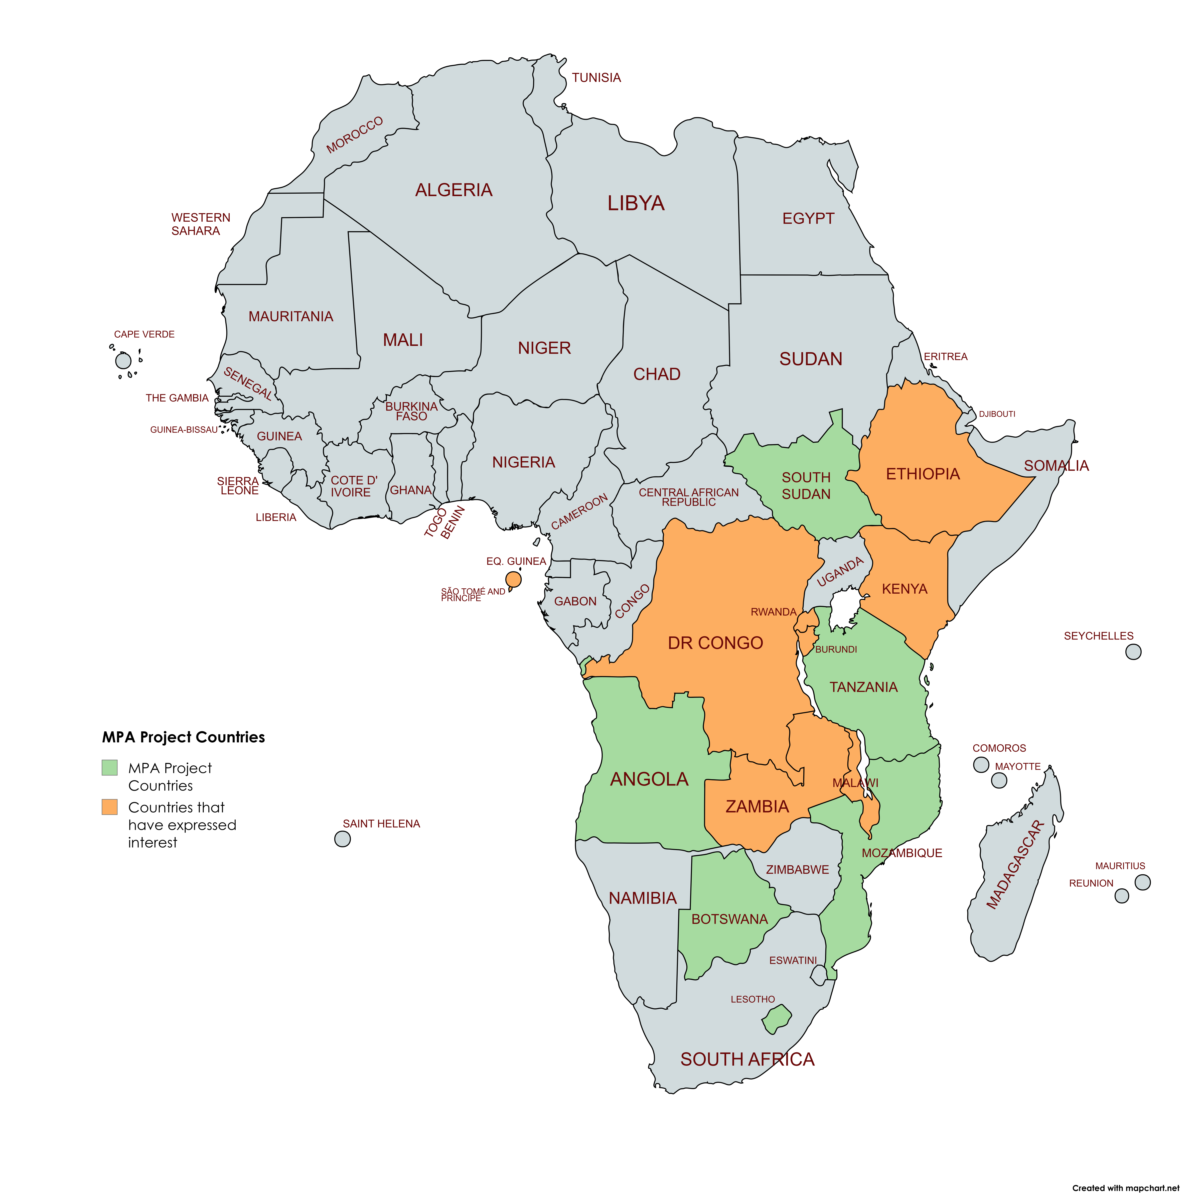
The Program Development Objective (PrDO) of the Health Emergency Preparedness, Response and Resilience (HEPRR) Program is to strengthen health system resilience and multisectoral preparedness and response to health emergencies in Eastern and Southern Africa.
Component 1: Strengthening the preparedness and resilience of regional and national health systems to manage health emergencies
Component 2: Improving the detection and response to health emergencies at the regional and national level through a multi-sectoral approach
Component 3: Program Management
Contingent 4: Emergency Response Component
Sep 2023
WB Board approval
Jan 17, 2024
ECSA-HC Effectiveness
Program Launch
Kenya, STP, Ethiopia, IGAD
Oct 24, 2023
Signing the Financing Agreement and project package
May 2025
June 2024
AWP approval
Commenced implementation

Slide 17
Strategic Recommendations
Integrate AMR and IPC into emergency coordination
Harmonize surveillance platforms
Train workforce across AMR/outbreaks
Improve public awareness
Create recovery funds

Slide 18
Conclusion
Epidemics and Outbreaks reveal AMR and IPC vulnerabilities and opportunities
AMR and IPC must be embedded in emergency frameworks
Key: adaptability, investment, regional unity

Slide 19
Thank You

